Slide 1

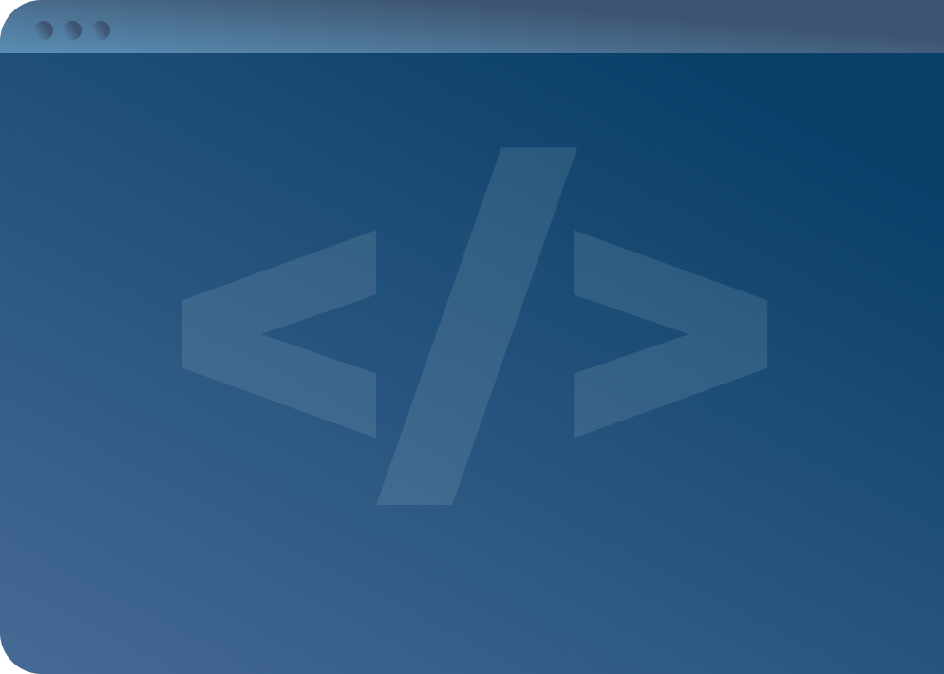

SOFTWARE DEVELOPMENT PROFESSIONAL PROGRAM
React: The useEffect Hook

Slide 2





React: The useEffect Hook
Learning Objectives
Contextualize the "useEffect" hook.
Discuss the component life cycle.
Trigger events on state changes.

Slide 3
React: The useEffect Hook
Listening for More Events
Now that we can track state:
Increment counters.
Store user inputs.
Toggle Boolean values.
Trigger a component re-render.
Notes:
As we learned in our state lesson, we have the power to capture user inputs and track changing variables.
But what if we want to make more impactful decisions with these actions/data?
What if we want to run code immediately after the DOM is updated?
Knowing our component triggers a re-render in this event is powerful.

Slide 4
React: The useEffect Hook
Enter useEffect
What if we perform a function each time a component is rendered?
useEffect
Notes:
'useEffect' is a React hook that tells your component it needs to perform a certain task immediately after rendering.
Whenever you know a page or event needs a "side effect" to run, you know you will be using the 'useEffect' hook.

Slide 5


React: The useEffect Hook
useEffect
When to useEffect
Fetching data
Reading from local storage
Registering and de-registering event listeners
From: ThriveDX

Slide 6
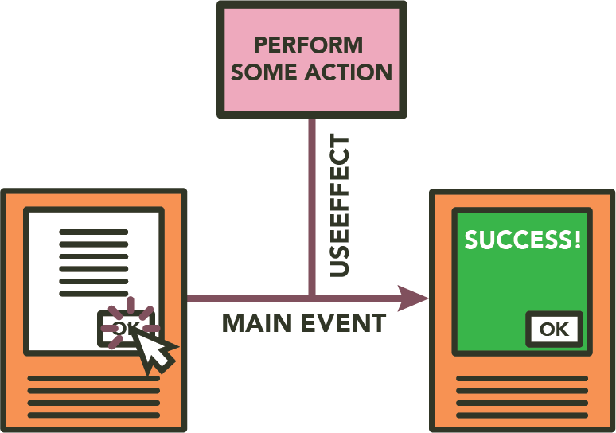
React: The useEffect Hook
useEffect
From: ThriveDX
Notes:
Because updating a node in state triggers a re-render, we know we can cause 'useEffect' to perform meaningful tasks that
are not strictly scoped to the DOM.
In this diagram, it may be useful to describe a particular event occurring. Some good use-case examples include:
- Manually updating DOM properties to reflect state
- Toggling the view of a component by listening to a Boolean state value
- Manually subscribing to events to listen for so that one may subvert strictly using state properties
At this point, some learners may be overwhelmed by the potential complexity of scope that we are introducing with 'useEffect'.
There is no need to worry, though.
The following slides will be examples of some simple use cases.

Slide 7

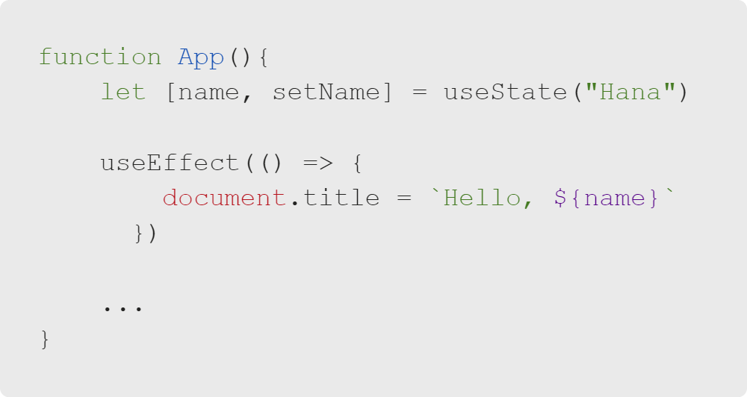
React: The useEffect Hook
useEffect
A practical use for useEffect
Manually updating the DOM
Notes:
In this example, we see 'useEffect' handling a manual DOM update: updating the 'document.title' property.
Each time the element re-renders, the 'useEffect' callback fires, and the title is updated to reflect state.
Note: This is an artificial example. The code will not run as it is currently written.

Slide 8
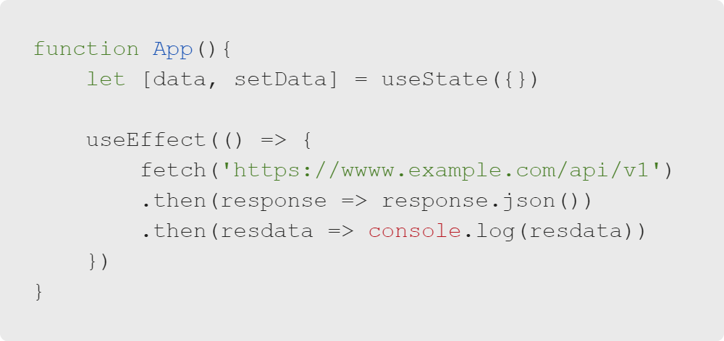
React: The useEffect Hook
Fetching Data
Another practical example:
Fetching data from an external resource
Notes:
Often, React documentation will pose what we place within the 'useEffect' as a "side effect." What if I want my page to
trigger a "side effect" (fetch data, set a connection to a data source, log data, and manually mutate the DOM)?
This is a good example of a "side effect" in which we see data returned from an API call. But what if you want to render the data?
Perhaps we could store the value in a state variable, as we know a state variable will persist through re-renders.

Slide 9

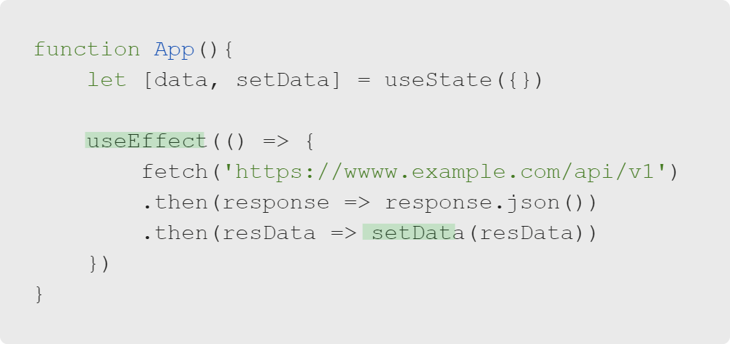
React: The useEffect Hook
Fetching Data
But wait!
What if we ran this code? What might happen?
Notes:
Pause to allow learners to discuss what this code is doing. Why will it cause an error? This code triggers an infinite loop.
'setState' causes the component to re-render; 'useEffect()' is triggered by a component rendering.

Slide 10

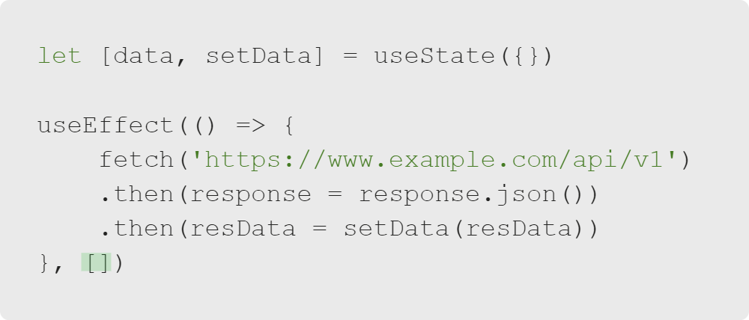
React: The useEffect Hook
The Dependency Array
There is a solution!
With a dependency array, we can control when the useEffect fires.
Notes:
Look carefully at the section highlighted in green at the bottom of the 'useEffect'. What is the second argument?
That is our dependency array! A dependency array can take a list of state variables that the 'useEffect' will listen for.
When we identify variables, the 'useEffect' will only fire when one of those variables changes.
In this case, we are using an "empty" dependency array, which means that after the component is first rendered to the DOM,
it will not run the 'useEffect' on subsequent re-renders. It has no dependencies to listen for.

Slide 11
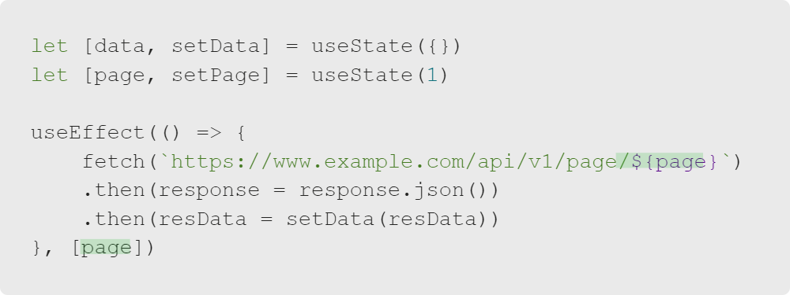
React: The useEffect Hook
The Dependency Array
In this case, we want to re-run the useEffect.
By using a dependency array, we can identify a variable that will change, and we can trigger a fresh useEffect on that action!
Notes:
In this example, we can imagine the API has a pagination system that serves only a certain amount of data at a time.
If we keep track of the page number in state, every time the user changes that variable, we can re-run the 'useEffect' to fetch fresh data.
Note: The changed variable would be set outside the 'useEffect'.

Slide 12
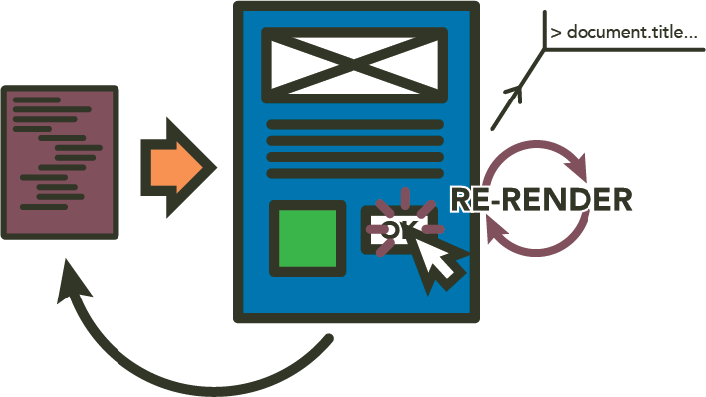
React: The useEffect Hook
Wrapping Up
This may seem like a lot!
From: ThriveDX
Notes:
This may seem like a lot! There are many intricacies when we start practicing with 'useEffect'.
We now will think about the things we have learned and practice with them.

Slide 13

React: The useEffect Hook
Wrapping Up
What we have learned:
useEffect is how we can handle "side effects."
By default, useEffect will run on each render.
We can limit how often a useEffect fires.
Now we will try using useEffect.
Notes:
This has been a lot of material. Encourage learners to discuss this topic during the activity, as it can be complex.

